Slide 1




Slide 2


PRAYING FOR BARBADOS

Slide 3
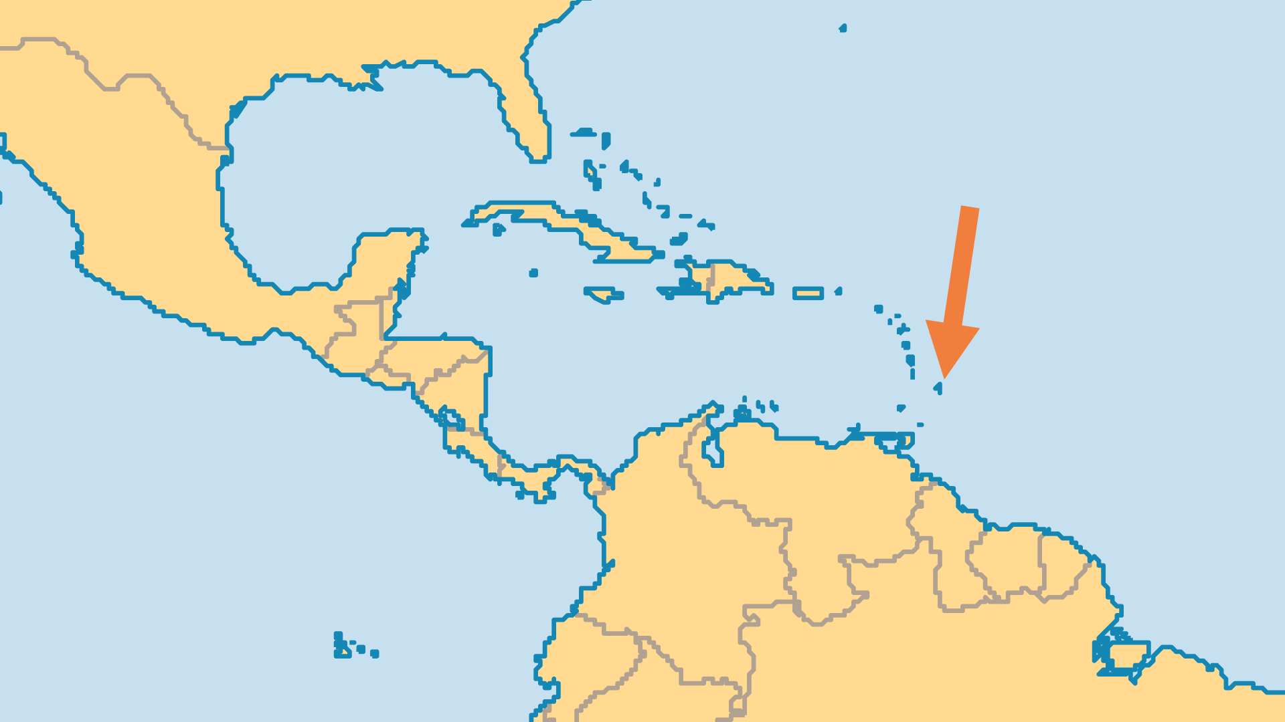
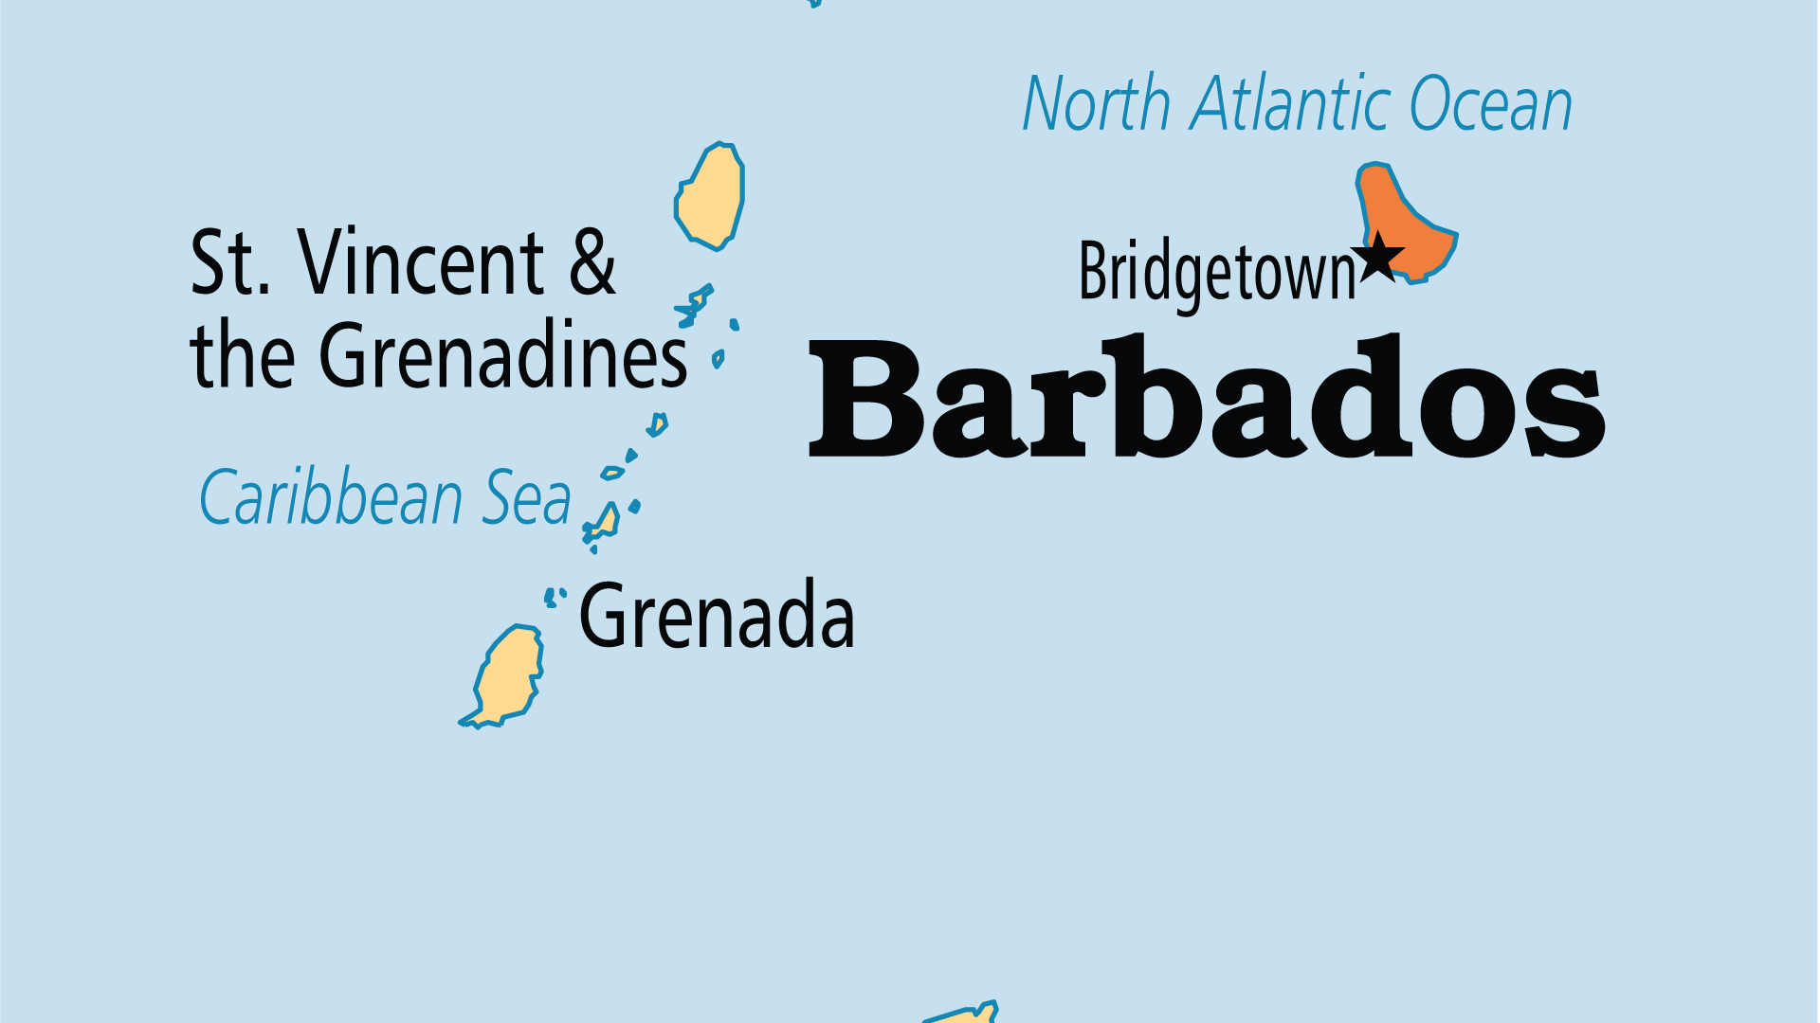
KEY STATS
Capital: | Bridgetown
Population: | 282,624
Pop Under 15 Yrs: | 17.1 %
Official Language: | English. Barbadian creole
Languages: | 3
Literacy Rate: | 99 %
HDI Ranking: | 70/193
% Christian: | 94.9 %
% Evangelical: | 34.2 %
Largest Religion: | Christian
% Unevangelized: | 1 %

Slide 4

FOR PRAYER
Since settlement in 1627, Barbados has been Christian. But despite overwhelming religious profession and a large number of evangelicals, real commitment to the lordship of Jesus is the exception rather than the rule. Materialism, spreading theological liberalism, decreasing church attendance, increased violence and crime are all symptoms of spiritual decline. Pray for the Spirit's renewal and for the Church in Barbados to reawaken.
Want to know more? Go to www.operationworld.org

